Slide 1
Kubernetes Intermediate
Training

Slide 2
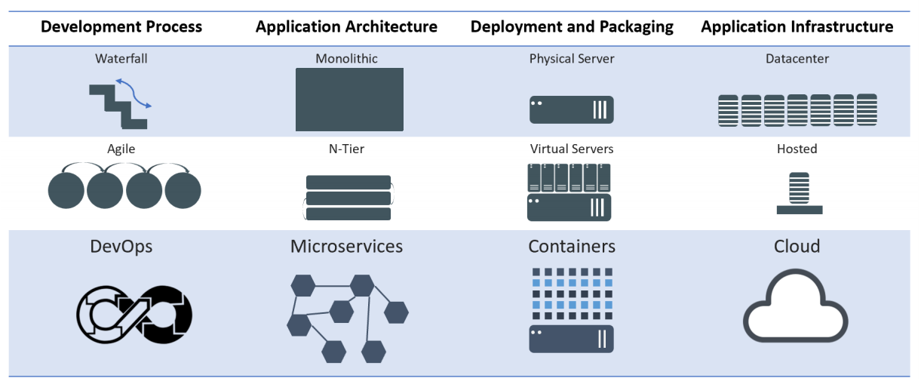
Evolution of Computing
Notes:
Mention WHY the evolution and benefits of adapting to new practices

Slide 3
Architecture Overview
Masters - Acts as the primary control plane for Kubernetes. Masters are responsible at a minimum for running the API Server, scheduler, and cluster controller. They commonly also manage storing cluster state, cloud-provider specific components and other cluster essential services.
Nodes - Are the ‘workers’ of a Kubernetes cluster. They run a minimal agent that manages the node itself, and are tasked with executing workloads as designated by the master.

Slide 4
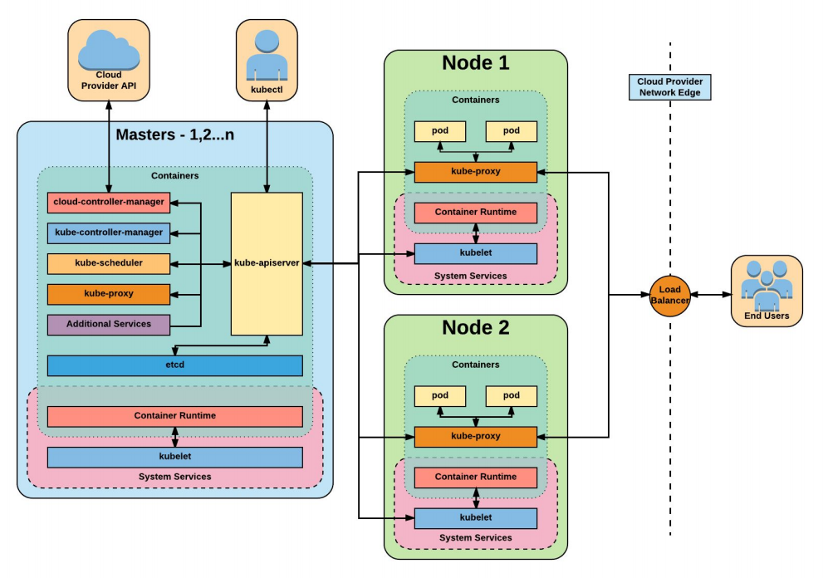

Slide 5
Installation
Install Minikube and Kubectl
https://github.com/arjunachari12/install-jenkins-container/blob/main/kubernetes.md

Slide 6
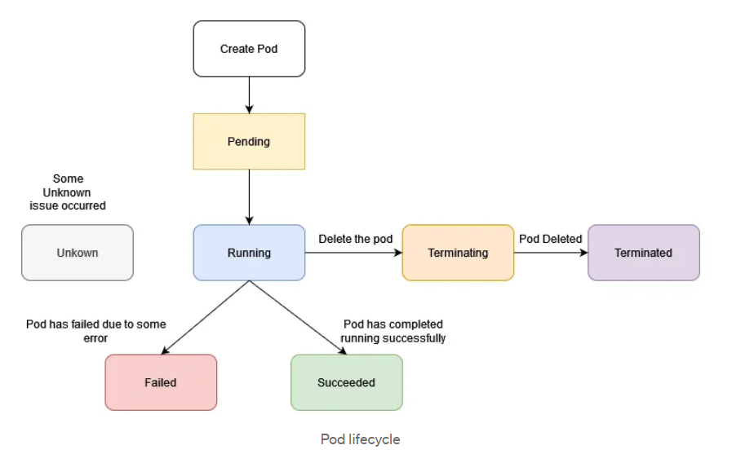
Pods lifecycle

Slide 7
Exercise: Run image as pod
Hands-on steps:
Step 1: Open VS code and create new folder
Step 2 : write manifest file pod.yml, copy code from below link
https://github.com/arjunachari12/k8s-learn/blob/main/pod.yml
Step 3: Execute pod.yml file using below command
kubectl create -f pod.yml
Step 4: You should see pod created message
Step 5: run below commands
kubectl get pod
kubeclt describe pod pod
kubectl delete pod

Slide 8
Assignment: Run multiple images as pod
Hands-on steps:
Step 1: Open VS code and create new folder
Step 2 : write manifest file pod.yml, copy code from below link
https://github.com/arjunachari12/k8s-learn/blob/main/pod2.yml
Step 3: Execute pod.yml file using below command
kubectl create -f pod2.yml
Step 4: You should see pod created message
Step 5: run below commands
kubectl get pod
kubeclt describe pod pod1
kubectl delete pod pod1

Slide 9
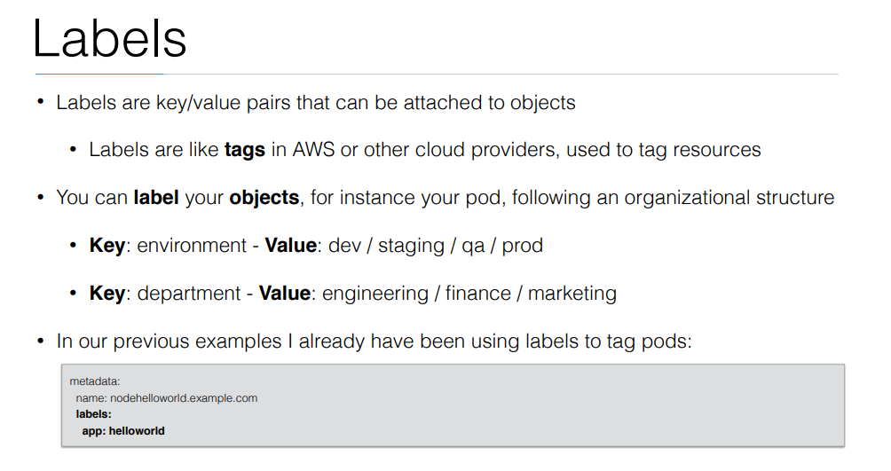

Slide 10
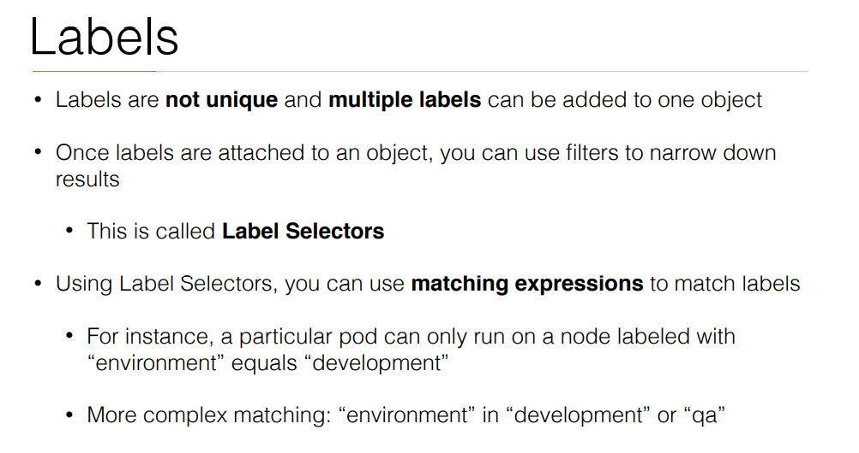

Slide 11
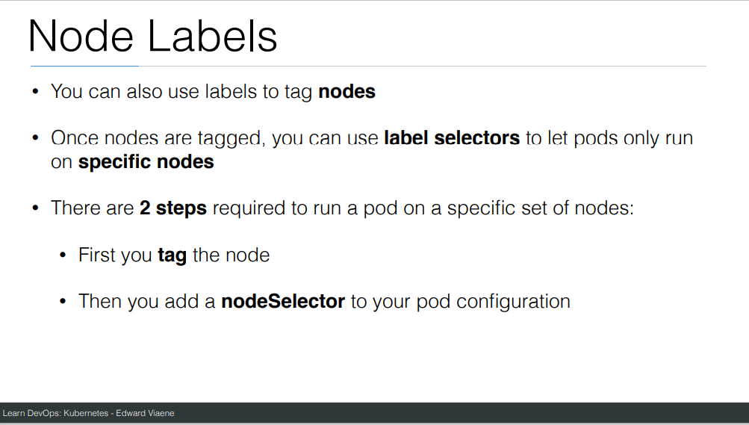

Slide 12
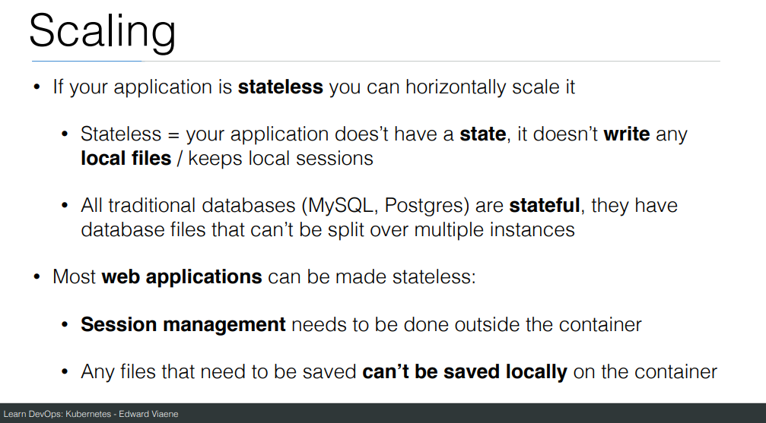

Slide 13
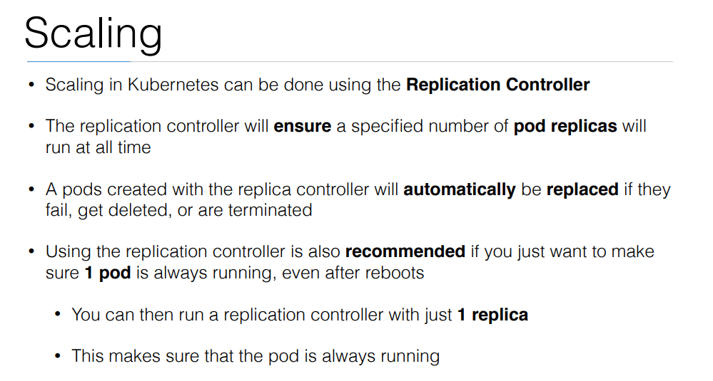

Slide 14
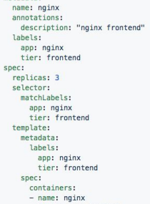
ReplicaSet
Generated ReplicaSet from Deployment spec.

Slide 15
Replicaset
kubectl create -f helloworld_replicaset.yaml
kubectl get rs
kubectl autoscale rs helloworld-controller --max=5
kubectl delete rs helloworld-controller
kubectl edit pods helloworld-controller-9jlsq

Slide 16
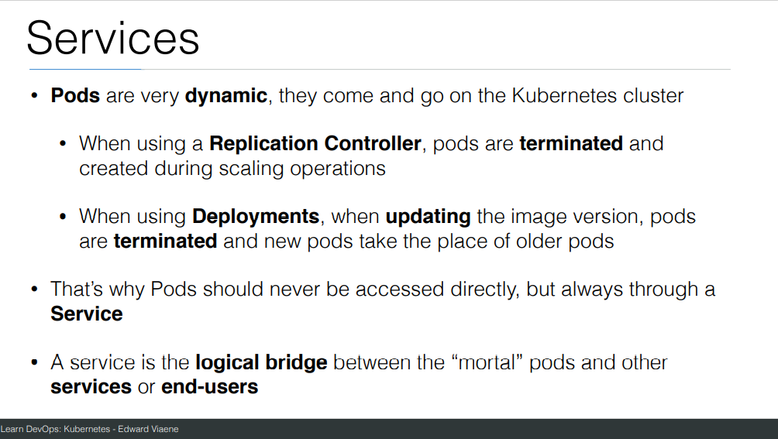

Slide 17
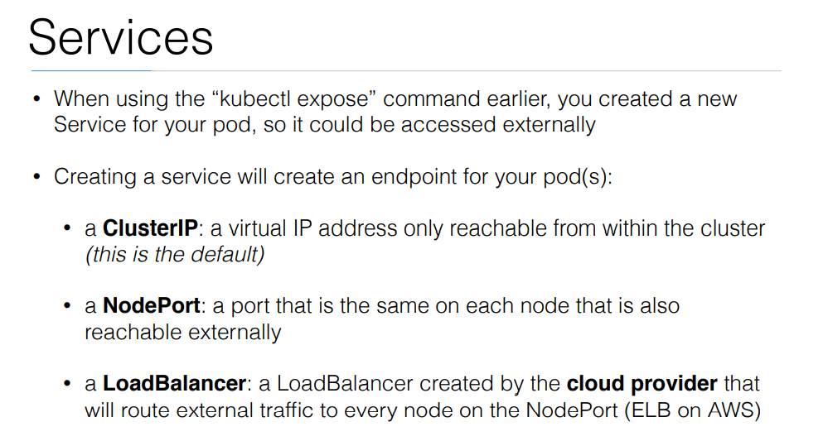

Slide 18
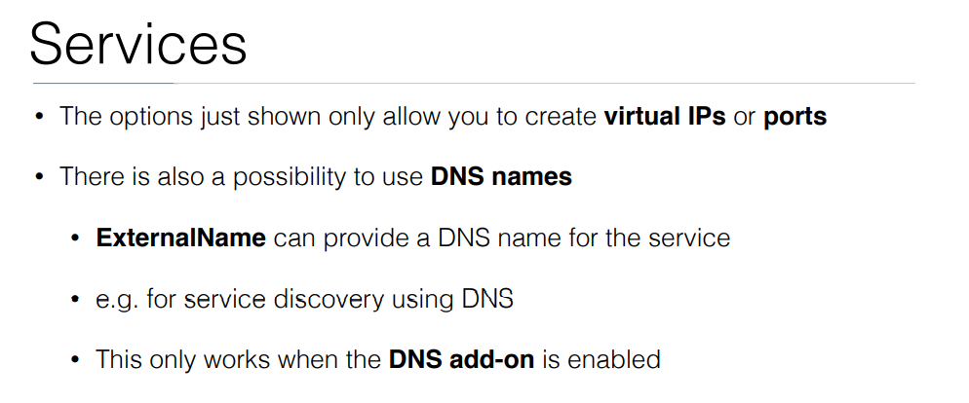

Slide 19
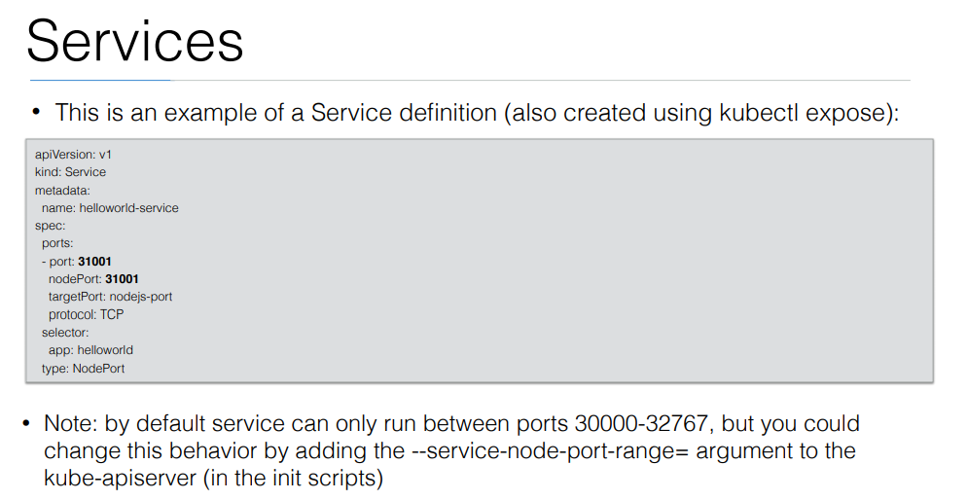

Slide 20
Exercise: Run image as pod
Hands-on steps:
Step 1: Open VS code and create new folder
Step 2 : write manifest file pod3.yml, copy code from below link
https://github.com/arjunachari12/k8s-learn/blob/main/pod3.yml
Step 3: Execute pod.yml file using below command
kubectl create -f pod3.yml
Step 4: You should see pod created message
Step 5: run below commands
kubectl get pod
kubeclt describe pod pod3

Slide 21
Exercise: Expose pod as Service
Hands-on steps:
Step 1: Open VS code and create new folder
Step 2 : write manifest file pod3-service.yml, copy code from below link
https://github.com/arjunachari12/k8s-learn/blob/main/pod3-service.yml
Step 3: Execute pod3-service.yml file using below command
kubectl create -f pod3-service.yml
Step 4: You should see pod created message

Slide 22
Exercise: Expose pod as Service
Hands-on steps:
Step 5: run below commands
kubectl get pod
kubeclt describe pod pod3
kubectl get svc
minikube service helloworld-service --url
kubectl describe svc helloworld-service
kubectl describe svc
Kubectl get svc
kubectl delete svc helloworld-nodeport-service.yml

Slide 23
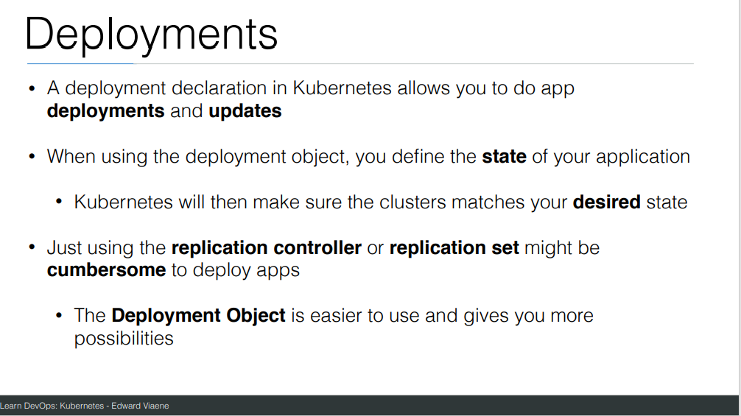

Slide 24
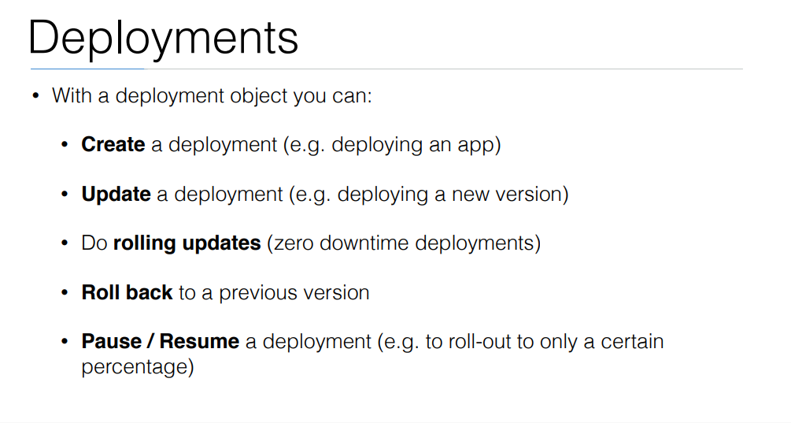

Slide 25
commands
Create a file called helloworld-deployment.yaml
Copy content from https://github.com/arjunachari12/k8s-learn/blob/main/helloworld-deployment.yml
kubectl create -f helloworld-deployment.yaml
kubectl get deployments
kubectl get rs
kubectl get pods
kubectl get pods --show-labels
kubectl rollout status deployment/helloworld-deployment

Slide 26
commands
Created new version of docker image and uploaded in docker hub
kubectl expose deployment helloworld-deployment --type=NodePort
kubectl get svc
minikube service helloworld-deployment --url
Curl url
kubectl set image deployment/helloworld-deployment k8s-demo=arjunachari12/k8s-demo:2
see
Curl to see new version

Slide 27
commands
kubectl get pods
kubectl rollout history deployment/helloworld-deployment
kubectl get pods
kubectl rollout undo deployment/helloworld-deployment
Curl again #modify history count
kubectl edit deployment/helloworld-deployment

Slide 28
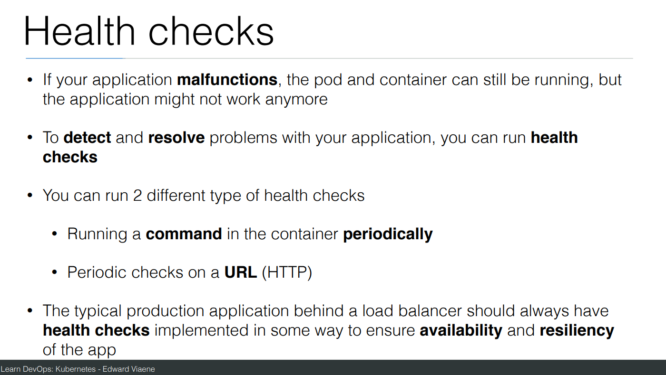

Slide 29
Commands
Create a file helloworld-healthcheck.yml
kubectl create -f helloworld-healthcheck.yml
kubectl describe pod helloworld-deployment-7cfbb8fccf-78bxk
kubectl edit deployment/helloworld-deployment
#This will immediately run
kubectl create -f helloworld-healthcheck.yml && watch -n1 kubectl get pods

Slide 30
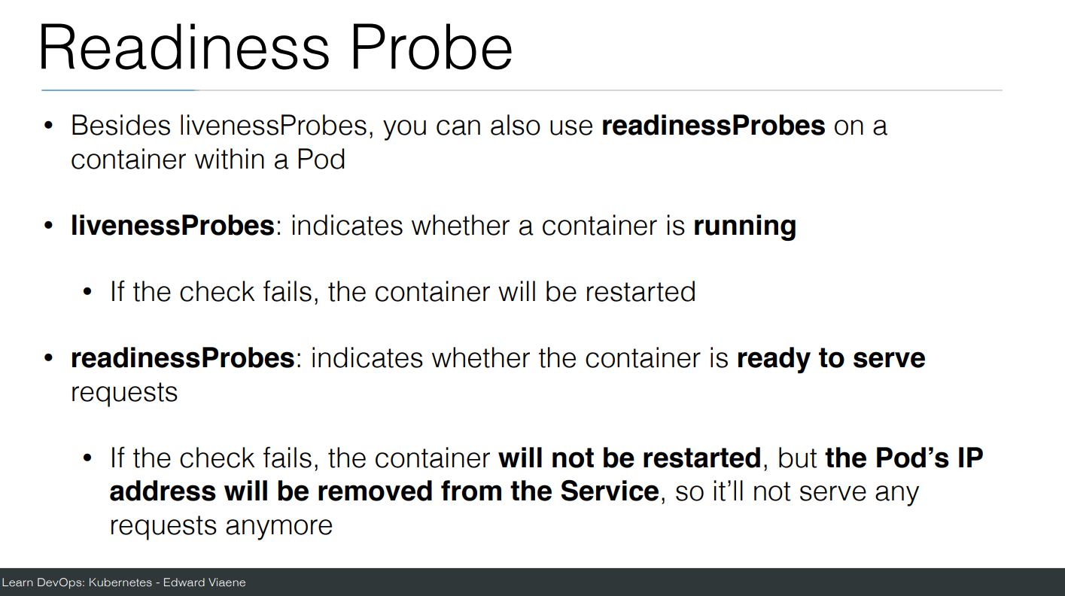

Slide 31
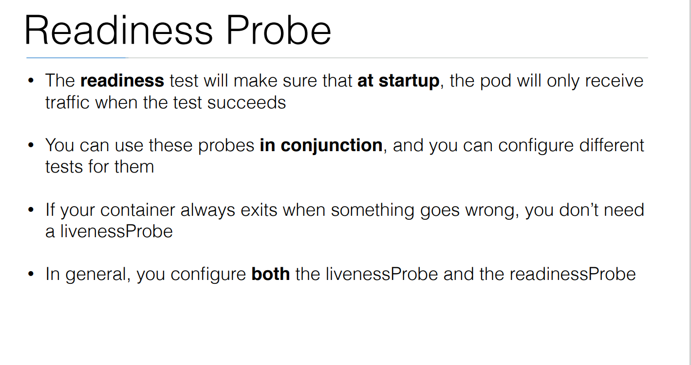

Slide 32
Commands
Create a file helloworld-liveness-readiness.yml
kubectl create -f helloworld-liveness-readiness.yml && watch -n1 kubectl get pods

Slide 33
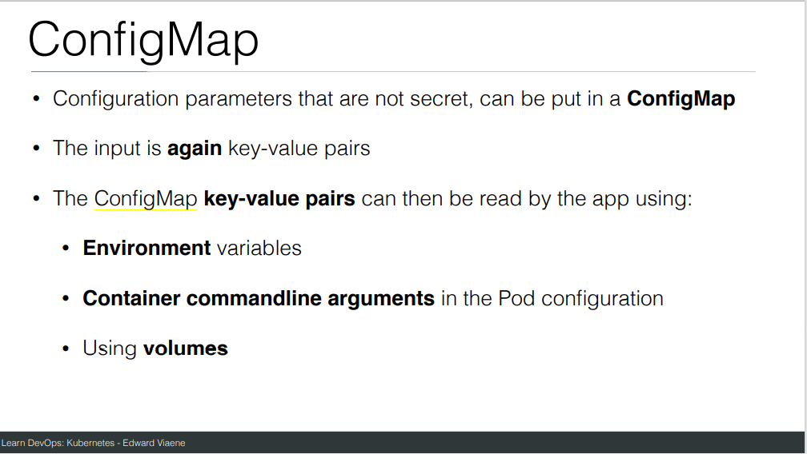

Slide 34
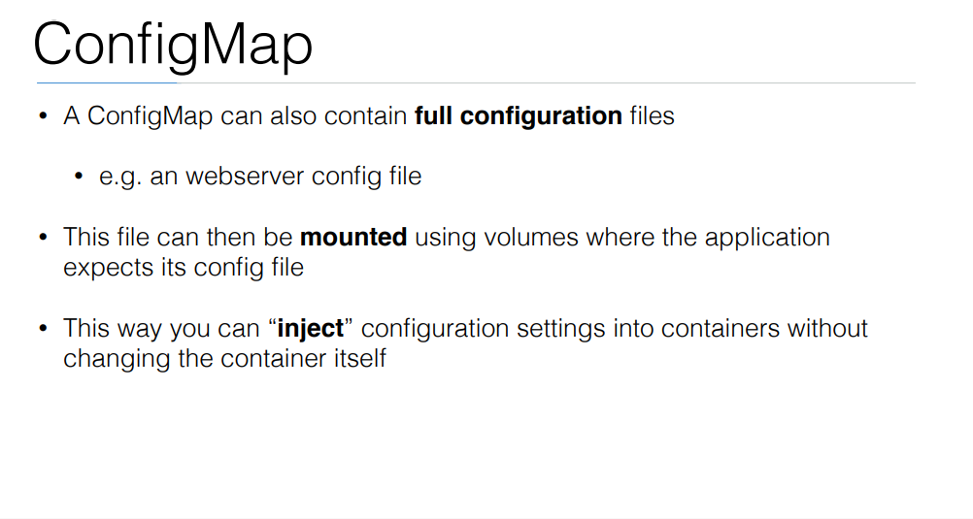

Slide 35
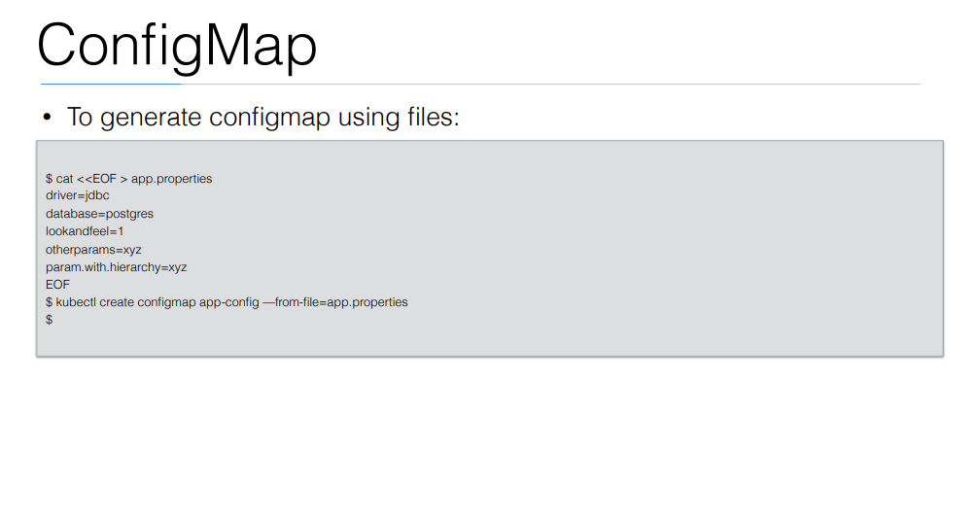

Slide 36
Exercise: Configmap
Create file and copy below content
https://github.com/arjunachari12/k8s-learn/blob/main/pod-configmap.yml
Run the file

Slide 37
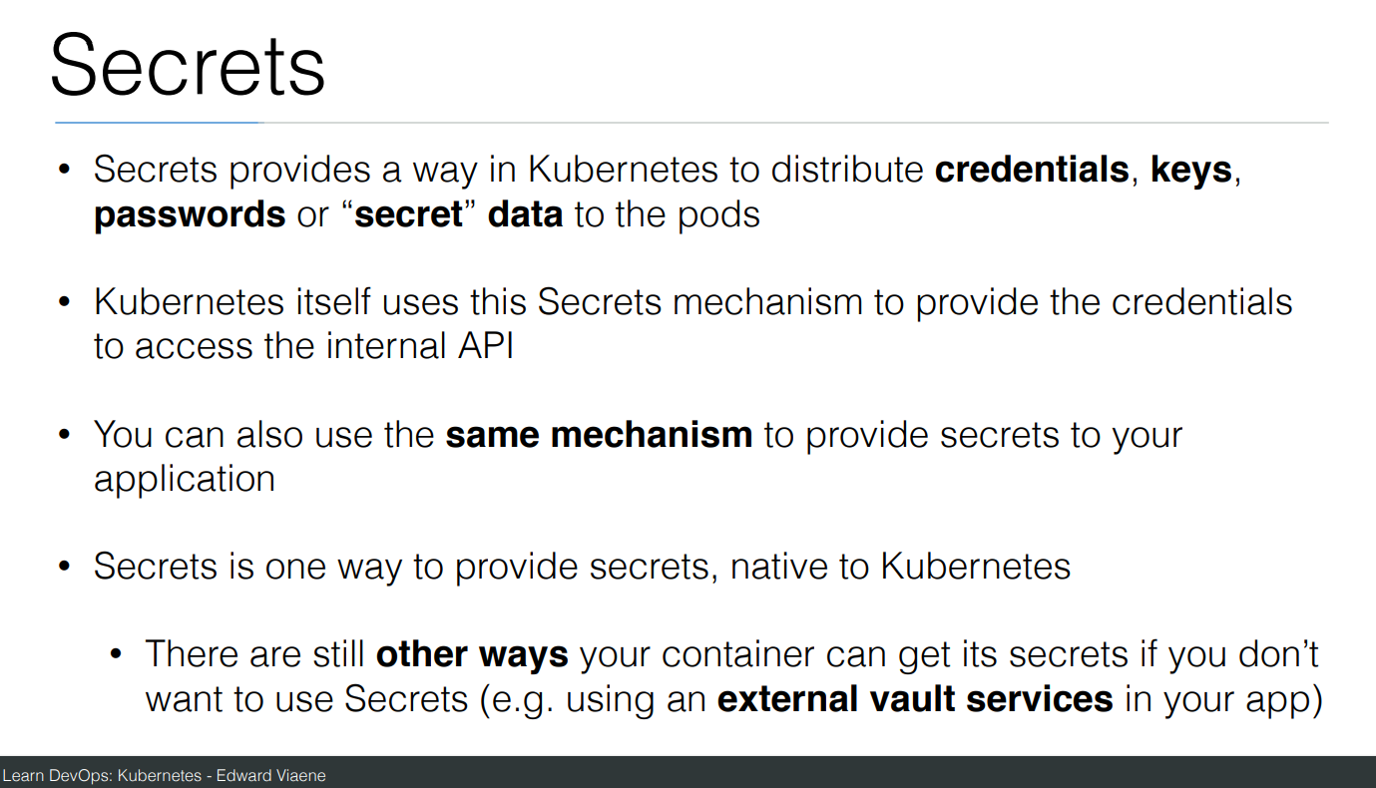

Slide 38
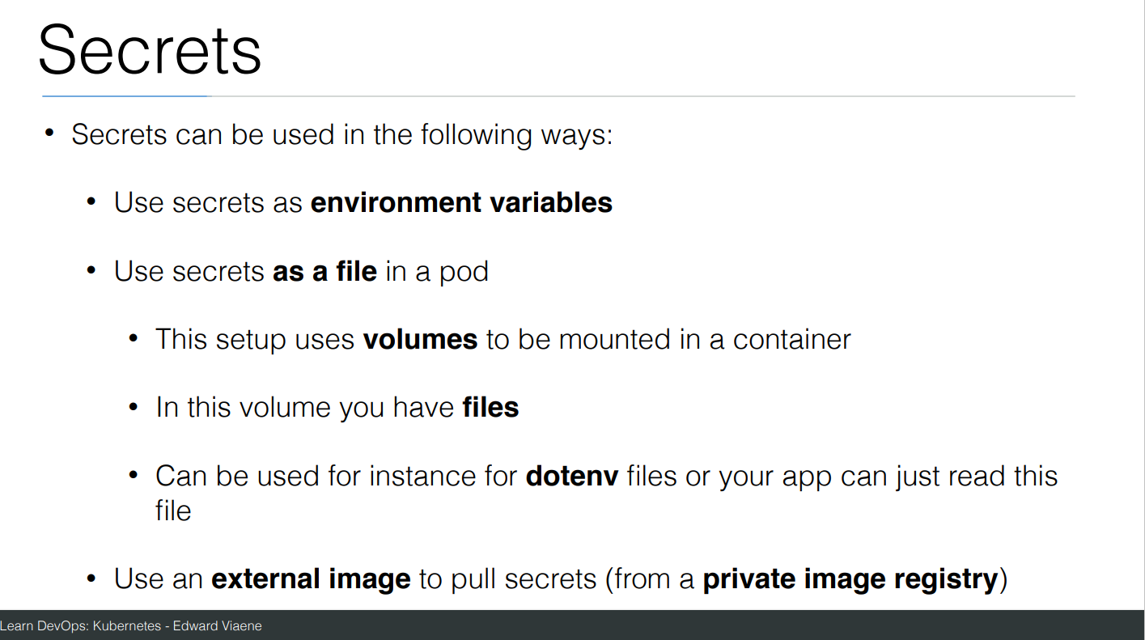

Slide 39
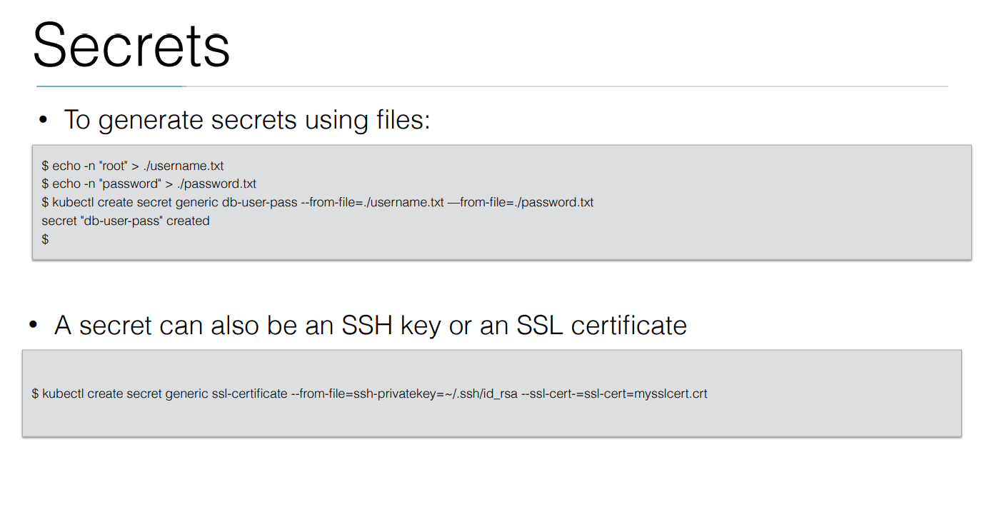

Slide 40
Exercise: Secrets
Create file and copy below content
https://github.com/arjunachari12/k8s-learn/blob/main/secrets.yaml
Run the file
Create file and copy below content
https://github.com/arjunachari12/k8s-learn/blob/main/database.yml
Run the file

Slide 41
Volume
On-disk files in a container are ephemeral, which presents some problems for non-trivial applications when running in containers.
One problem occurs when a container crashes or is stopped.
Container state is not saved so all of the files that were created or modified during the lifetime of the container are lost.
During a crash, kubelet restarts the container with a clean state. Another problem occurs when multiple containers are running in a Pod and need to share files.
It can be challenging to setup and access a shared filesystem across all of the containers

Slide 42
Ephemeral Volumes
Some application need additional storage but don't care whether that data is stored persistently across restarts.
For example, caching services are often limited by memory size and can move infrequently used data into storage that is slower than memory with little impact on overall performance.
Other applications expect some read-only input data to be present in files, like configuration data or secret keys.
Ephemeral volumes are designed for these use cases. Because volumes follow the Pod's lifetime and get created and deleted along with the Pod, Pods can be stopped and restarted without being limited to where some persistent volume is available.

Slide 43
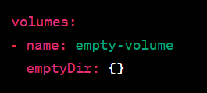
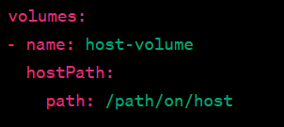
Types of ephemeral volumes
EmptyDir:
A simple volume that is initially empty when a pod is created.
Data in an EmptyDir volume is ephemeral and is lost when the pod is deleted or rescheduled.
HostPath:
Mounts a file or directory from the host node's filesystem into the pod.
Useful for accessing local files or sharing data between the host and the pod.

Slide 44
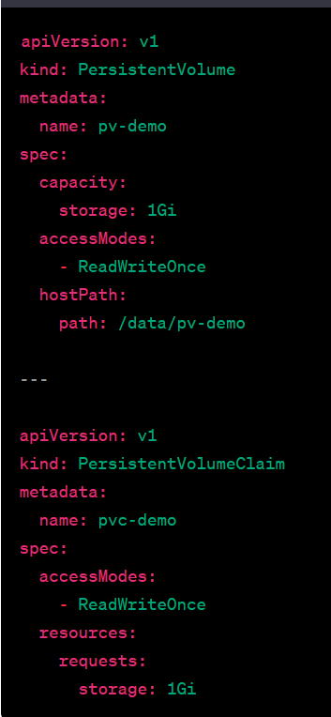
Types of ephemeral volumes
PersistentVolume (PV) and PersistentVolumeClaim (PVC):
PV represents a piece of networked storage in the cluster.
PVC is a request for storage by a user.
PVs and PVCs enable data persistence beyond the pod lifecycle and are used for more advanced storage scenarios.

Slide 45
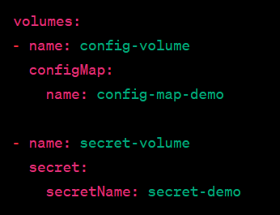
Types of ephemeral volumes
ConfigMap and Secret Volumes
Allow pods to consume ConfigMaps or Secrets as volumes.
Useful for configuration data or sensitive information.

Slide 46
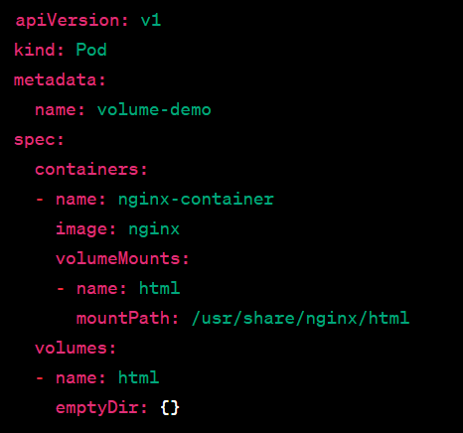
Volume Mounts
Volume mounts are where volumes are attached within the container's filesystem.
Containers in the same pod can share data through volume mounts.
https://kubernetes.io/docs/tasks/configure-pod-container/configure-persistent-volume-storage/

Slide 47
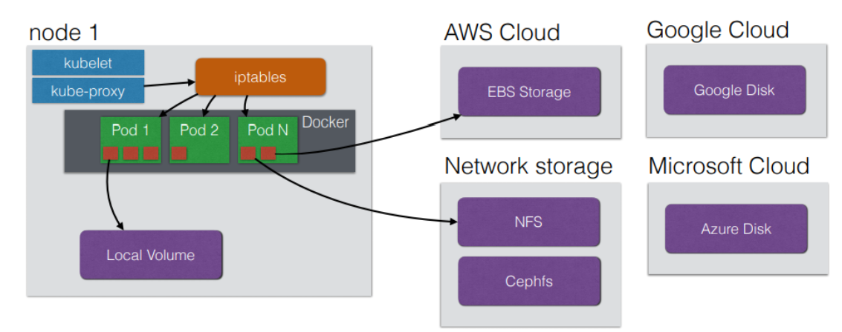
StorageClass
a StorageClass is an abstraction that defines the properties and parameters for dynamically provisioning storage volumes.

Slide 48
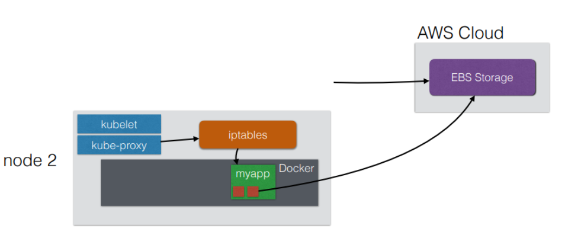
StorageClass
It allows users to describe the "class" of storage they need and enables dynamic provisioning based on that description. StorageClass provides a way to abstract the underlying storage infrastructure, making it easier to manage and scale storage in a Kubernetes cluster.

Slide 49
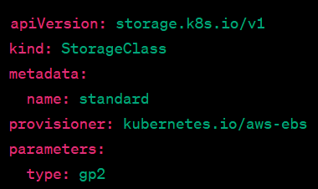
StorageClass
Dynamic Provisioning: StorageClass enables dynamic provisioning of persistent volumes (PVs). When a user requests storage and doesn't specify a particular PV, Kubernetes uses the StorageClass to dynamically provision a suitable PV.
Parameters: StorageClasses can include parameters that define the characteristics of the storage to be provisioned. These parameters are specific to the storage provider or the storage system being used.

Slide 54
Exercise: Run image as pod
Hands-on steps:
Step 1: Open VS code and create new folder
Step 2 : write manifest file pod3.yml, copy code from below link
https://github.com/arjunachari12/k8s-learn/blob/main/pod3.yml
Step 3: Execute pod.yml file using below command
kubectl create -f pod3.yml
Step 4: You should see pod created message
Step 5: run below commands
kubectl get pod
kubeclt describe pod pod3

Slide 55
Exercise: Expose pod as Service
Hands-on steps:
Step 1: Open VS code and create new folder
Step 2 : write manifest file pod3-service.yml, copy code from below link
https://github.com/arjunachari12/k8s-learn/blob/main/pod3-service.yml
Step 3: Execute pod3-service.yml file using below command
kubectl create -f pod3-service.yml
Step 4: You should see pod created message

Slide 56
Exercise: Expose pod as Service
Hands-on steps:
Step 5: run below commands
kubectl get pod
kubeclt describe pod pod3
kubectl get svc
minikube service helloworld-service --url
kubectl describe svc helloworld-service
kubectl describe svc
Kubectl get svc
kubectl delete svc helloworld-nodeport-service.yml

Slide 57
Ingress
In Kubernetes, an Ingress is an API object that manages external access to services within a cluster, typically HTTP or HTTPS traffic.
It provides a way to expose your services to the outside world by routing traffic based on hostnames or paths to specific services running in the Kubernetes cluster.

Slide 58
Ingress
Ingress Controller:
This is a specialized load balancer responsible for fulfilling the Ingress rules. It watches the Kubernetes API for changes in Ingress objects and updates the routing configurations.
Common controllers include NGINX, Traefik, and HAProxy.
Ingress Resource:
This defines how traffic should be routed. You can specify rules that map requests (e.g., based on hostnames, paths) to corresponding services within the cluster.
Example: Traffic to myapp.example.com goes to the backend service myapp-service.

Slide 59
Features of Ingress
Path-based Routing: You can route traffic to different services based on URL paths.
Example: /api could be routed to one service, while /admin could be routed to another.
Host-based Routing: Ingress allows you to route based on the hostname (e.g., app1.example.com goes to one service, and app2.example.com to another).
TLS/SSL Termination: Ingress can handle SSL termination, which means it can handle HTTPS requests, often using certificates managed by Kubernetes secrets.
Load Balancing: Ingress provides a way to load balance traffic across multiple instances of your services.
Rewrite Rules and Headers: Some Ingress controllers support rewriting URL paths or adding/removing headers for requests.

Slide 60
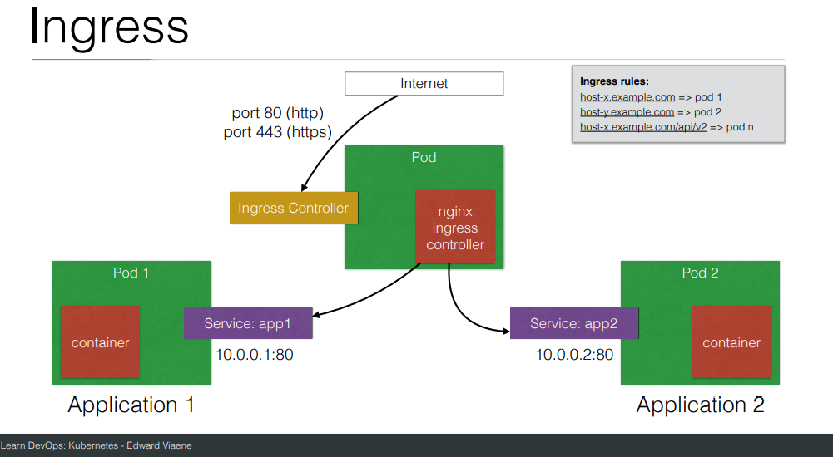

Slide 61
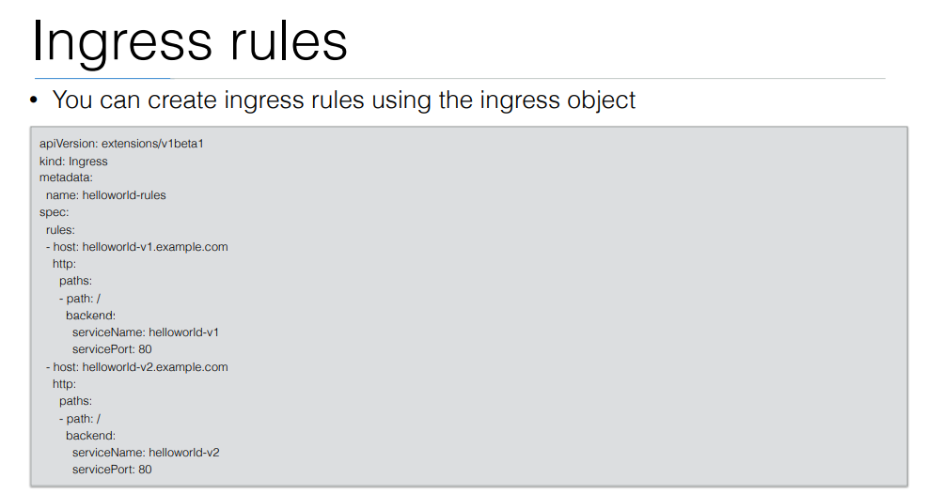

Slide 62
Pod scheduling
Pod scheduling in Kubernetes refers to the process by which the Kubernetes scheduler selects the most suitable node to run a pod.
This process ensures that the pod can function optimally while meeting any specific constraints or requirements.

Slide 63
pod scheduling process
1. Pod Requirements and Node Suitability
Before scheduling, Kubernetes evaluates each pod's requirements (resource needs, constraints, and any other scheduling rules) and matches them against the available nodes in the cluster. Some important factors include:
Resource requests: CPU, memory, and storage requirements.
Node affinity: Specific rules that determine whether a pod prefers or requires certain types of nodes (e.g., nodes with specific labels).
Taints and tolerations: Mechanisms to prevent pods from being scheduled on certain nodes unless the pod has a specific tolerance.
Pod affinity and anti-affinity: Rules that define whether a pod prefers or needs to be located near (or far from) other pods.
Node selectors: Conditions that filter nodes based on custom labels.

Slide 64
pod scheduling process
2. Filtering
Kubernetes first filters the nodes that can potentially run the pod. It excludes nodes that:
Don't have the necessary resources to satisfy the pod's resource requests.
Have taints that the pod doesn't tolerate.
Don't match the required labels (if nodeSelector or affinity rules are applied).

Slide 65
pod scheduling process
3. Scoring
Once Kubernetes identifies all nodes that meet the filtering criteria, it scores the nodes. Scoring helps the scheduler determine the best node based on factors such as:
Resource availability: Nodes with the most available resources might be preferred.
Pod distribution: The scheduler might aim to balance workloads across nodes to avoid hotspots.
Affinity rules: Nodes that match affinity preferences are scored higher.
Spread constraints: For example, distributing pods across zones or racks for availability purposes.

Slide 66
pod scheduling process
4. Binding
After scoring, Kubernetes selects the node with the highest score and binds the pod to that node. The pod is then scheduled to run on that specific node.
Common Features in Pod Scheduling:
Taints and Tolerations: Nodes can have "taints" that prevent pods from being scheduled on them unless those pods have corresponding "tolerations." This feature is often used to isolate certain nodes for specific workloads.
Affinity/Anti-affinity: You can define rules that control whether a pod is scheduled on the same node as another pod (affinity) or on different nodes (anti-affinity). This helps in spreading or grouping related workloads.
Preemption: When resources are scarce, higher-priority pods can preempt lower-priority pods, causing the lower-priority ones to be evicted to free up resources.

